Slide 1
IBM University Engagement Project Submission
Exploring the Power of Agentic AI with IBM Granite and watsonx.ai for Intelligent Fitness Coaching

Slide 2
Project Tile – [An AI-Powered Personal Fitness Coach using IBM Granite and watsonx.ai]
Domain of Project – [Healthcare | Artificial Intelligence | Fitness & Wellness]
Student Name | Recent Passport Photo | Email ID | Mobile number [WhatsApp]
DUMPALA REVANTH REDDY |  | 238r1a66e9@cmrec.ac.in | 6304957285
Recommended font style and size: Font Style: Arial Font Size (Heading): 28
Font Size (Content): 20

Slide 3
Problem Statement -
Problem Statement: FitnessBuddy – AI-Powered Personal Fitness Coach
The Challenge
Maintaining physical fitness and a healthy lifestyle is essential for overall well-being, but many individuals struggle with workout planning, balanced nutrition, habit tracking, and monitoring their daily health progress. Information about effective exercises, healthy meal plans, BMI management, and fitness guidance is often scattered across multiple unreliable sources. Without personalized, real-time coaching, many users fail to achieve their fitness goals or maintain long-term healthy habits.
The Objective
Build an AI-powered Personal Fitness Coach that delivers personalized fitness guidance and health recommendations for individuals, fitness enthusiasts, and wellness professionals. The solution should:
Personalized Workout Plans – Recommend exercise routines based on age, BMI, fitness level, health conditions, activity level, and fitness goals.
AI Meal Planning – Generate personalized meal plans with calorie estimates and dietary recommendations using IBM Granite.
Health Tracking & Feedback – Allow users to log workouts, water intake, sleep, and daily activities while providing instant progress analysis.
Preventive Health Focus – Suggest healthy lifestyle practices, weight management strategies, and fitness recommendations for long-term wellness.
Multi-Agent System –
Fitness Knowledge Agent (provides exercise and wellness information)
Workout Recommendation Agent (creates personalized workout plans)
Nutrition Recommendation Agent (generates AI-powered meal plans)
Health Tracking Agent (monitors habits, BMI, and fitness progress)
Visualization Dashboard – Display daily and weekly workout statistics, BMI, calorie targets, nutrition insights, habit tracking, and overall progress toward fitness goals.

Slide 4
Proposed Solution -
Proposed Solution: AI-Powered Personal Fitness Coach
The proposed solution is a multi-feature AI-powered Personal Fitness Coach built using Python Flask, IBM watsonx.ai, and IBM Granite Foundation Models to provide personalized, real-time fitness guidance. The system addresses challenges in workout planning, nutrition management, BMI analysis, and healthy lifestyle tracking through an intelligent, modular architecture.
At its core, the solution uses IBM Granite models hosted on IBM watsonx.ai to analyze user profiles and generate personalized workout plans, meal recommendations, and fitness guidance. User information such as age, gender, height, weight, BMI, activity level, and fitness goals is securely processed to deliver accurate and context-aware recommendations.
The system consists of four key modules:
Fitness Knowledge Module provides intelligent fitness guidance and answers user queries using IBM Granite.
Workout Recommendation Module generates personalized daily and weekly workout plans based on BMI, activity level, and fitness goals.
Nutrition Recommendation Module creates customized meal plans with calorie estimates and healthy dietary suggestions according to user preferences.
Health Tracking Module monitors BMI, daily habits, water intake, workout progress, and overall fitness performance while providing continuous feedback and motivation.
The solution includes a user-friendly dashboard built using HTML, CSS, JavaScript, and Flask, which visualizes BMI, calorie targets, workout schedules, meal plans, notifications, and fitness progress through an interactive interface.
IBM watsonx.ai provides secure model deployment, AI inference, and governance, while IBM Granite Foundation Models power reasoning, personalization, and conversational fitness coaching.

Slide 5
Technology Used
Technology Used
• Python Flask – Used to develop the backend of the FitnessBuddy application, manage user requests, user authentication, API integration, and AI-powered fitness features.
• IBM Granite Model (ibm/granite-3-3-8b-instruct) with IBM watsonx.ai – Used for natural language understanding, reasoning, AI inference, personalized workout generation, meal planning, conversational fitness coaching, and responsible AI governance.
• IBM Cloud – Provides a secure, reliable, and scalable cloud platform for hosting IBM watsonx.ai services, IBM Cloud Object Storage, and managing AI resources.
• IBM Cloud Object Storage – Used to securely store and manage application data, user-related information, generated reports, and project assets in the cloud with high availability and scalability.
• GitHub & Render – GitHub is used for version control and source code management, while Render deploys the Flask application with automatic updates, making the FitnessBuddy platform publicly accessible.

Slide 6
Langflow component Used -
1) Chat Input – Interface where users enter fitness-related queries, health details, workout goals, or dietary preferences through an interactive chatbot.
2) IBM watsonx.ai Agent – Processes user inputs using IBM Granite Foundation Models to generate personalized workout plans, meal recommendations, BMI analysis, and fitness guidance.
3) IBM Granite Model – Granite-3.3-8B-Instruct → Provides natural language understanding, reasoning, and personalized AI-powered fitness coaching with real-time responses.
4) Chat Output – Displays AI-generated workout plans, meal recommendations, BMI insights, fitness tips, and health suggestions in a user-friendly format.
5) IBM Cloud Object Storage – Securely stores application assets, user-generated files, and project resources for reliable cloud-based access and management.
6) Flask Backend – Handles user authentication, profile management, AI request processing, dashboard functionality, and communication between the web application and IBM watsonx.ai services.

Slide 7

Role of Agentic AI in the solution
Role of Agentic AI in FitnessBuddy
Agentic AI enables FitnessBuddy to function as an intelligent, autonomous fitness and nutrition assistant rather than a simple chatbot. Powered by IBM watsonx.ai and IBM Granite models, it coordinates multiple specialized agents to deliver personalized fitness, nutrition, and wellness recommendations.
Each agent performs a dedicated task—such as generating AI meal plans, creating personalized workout plans, calculating BMI and health metrics, providing fitness coaching, and tracking user progress—while collaborating to deliver accurate and relevant recommendations. This multi-agent architecture ensures efficient task execution and an enhanced user experience.
Agentic AI also provides context awareness by understanding user information such as age, gender, height, weight, BMI, fitness goals, activity level, and dietary preferences. Based on this context, it generates personalized workout schedules, nutrition plans, and health insights tailored to each individual.
The system continuously adapts to user interactions by updating recommendations whenever users modify their profile, track habits, calculate BMI, or request new AI-generated meal and workout plans. The agents share information across modules, enabling better decision-making and personalized guidance.
Overall, Agentic AI makes FitnessBuddy proactive, personalized, and goal-driven, acting as a smart AI fitness coach that helps users maintain a healthier lifestyle through intelligent workout planning, nutrition guidance, BMI analysis, and continuous fitness tracking.

Slide 8
Novelty and Uniqueness
The proposed Fitness Buddy stands out by combining Generative AI, IBM watsonx.ai, and personalized fitness guidance into a single intelligent system.
AI-Powered Virtual Coach – Instead of a generic fitness chatbot, an intelligent AI assistant delivers personalized workout, nutrition, and wellness recommendations based on individual user needs.
IBM watsonx.ai Accuracy – Integrates IBM Granite models with advanced AI capabilities to generate reliable, context-aware, and trustworthy fitness guidance.
Hyper-Personalization – Tailors workout routines, diet suggestions, and wellness plans based on fitness goals, age, lifestyle, and user preferences.
Real-Time Interaction – Continuously adapts recommendations based on user queries, fitness progress, and changing health objectives for a dynamic experience.
Comprehensive Fitness Support – Provides guidance on workouts, nutrition, hydration, recovery, and healthy lifestyle practices through a single AI-powered platform.
Scalable & Enterprise-Ready – Built on IBM watsonx.ai with IBM Granite models, ensuring reliability, scalability, and enterprise-grade AI governance.
This makes the solution a smart, adaptive, and personalized virtual fitness coach, not just a static workout recommendation system.

Slide 9
Git Hub Link
Working GitHub Repository URL:
https://github.com/revanthreddy1122/fitness-buddy
Live Project URL:
https://fitness-buddy-gmdq.onrender.com
·
·
·

Slide 10
Future Scope
1. Integration with Wearables & Fitness Devices – The system can be integrated with smartwatches and fitness trackers to collect real-time data such as steps, heart rate, calories burned, workout sessions, and sleep patterns. This will enable Fitness Buddy to generate more personalized workout plans, monitor user progress, and provide intelligent health and fitness recommendations based on actual activity.
2. AI-Powered Voice Assistant & Multilingual Support – Enhancing the system with a voice-enabled AI assistant and support for multiple languages will improve accessibility and user engagement. Users can interact naturally in their preferred language to receive workout guidance, nutrition advice, and wellness recommendations, making the solution more inclusive and suitable for diverse users.
·
·
·

Slide 11
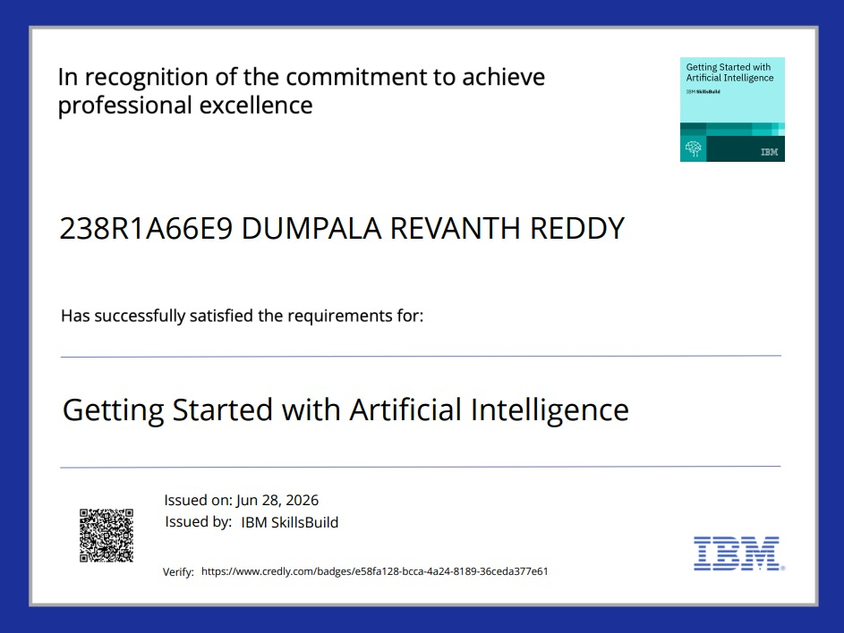
Certificates Earned:
Please add your credly certificate

Slide 12
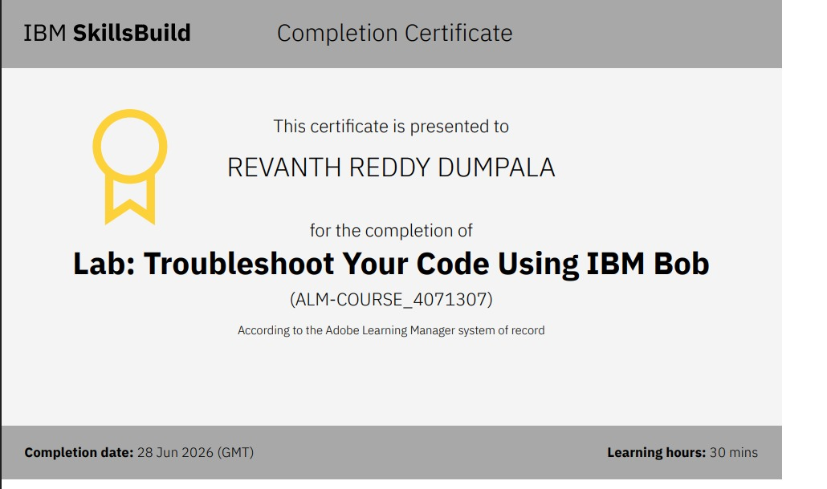
Certificates Earned:​
Add your IBM BOB Certificate

Slide 13
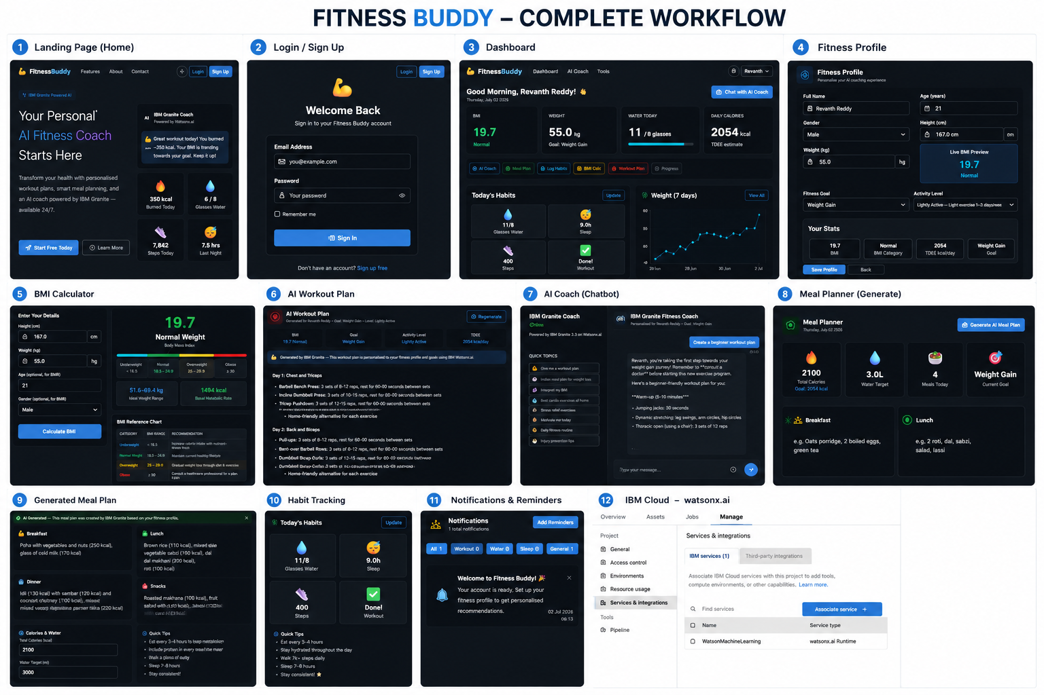

Slide 14


